Slide 1
LESSON 25.01 · WEEK 25
Why Do We Protect
National Parks?
NGSS 3-LS4-4 · Earth & Human Activity

Slide 2
OUR BIG QUESTION
Think About This...
"Why do people work hard to protect certain pieces of wild land?"
Hold this question in your mind as you work through the lesson. By the end, you should be able to answer it with evidence!

Slide 3
OBJECTIVES
I Can Statements
I can explain what protected land is and give an example.
I can describe how biodiversity helps a habitat stay healthy.
I can explain how human choices can harm or help wild habitats.
Notes:
Readiness map: I Can #1 (protected land, example) rehearsed in Section 1 (Slide 10) and the national park biodiversity photo (Slide 9). I Can #2 (biodiversity keeps habitat healthy) rehearsed in Section 2 (Slide 11) and the roles-in-a-food-web tap diagram (Slide 13). I Can #3 (human choices harm/help habitats) rehearsed in Section 3 (Slide 12), the Compare Two Places investigation (Slides 19-21), and the formal Write & Explain (Slide 28). All three assessed in Self-Check (Slides 23-25) and Assignment (Slides 26-28).

Slide 4
YOU'LL NEED
Materials
Science notebook
Pencil & colored pencils
Ruler (for charts)

Slide 5
NOTICE & WONDER
What Do You Already Know?
Think about a wild place — a forest, a wetland, a mountain. Wild places are full of living things. Some are easy to spot, like deer or oak trees. Many are small and hidden, like beetles and mosses.
WHAT DO YOU NOTICE? WHAT DO YOU WONDER?
Write down 3 things you think you'd find in a national park. Then write 1 question: why do you think people protect these places?

Slide 6
WORD WALL
Key Vocabulary — Part 1
Protected Land
Land the government sets aside to keep wild and safe from harmful development.
Biodiversity
The variety of different plants and animals living together in one place.
Habitat
The natural home where a plant or animal finds food, water, and shelter.

Slide 7
WORD WALL
Key Vocabulary — Part 2
Conservation
Working to protect and care for nature so it stays healthy over time.
Ecosystem
All the living things in a place — plus the soil, water, and air they share.
Preserve
To keep something safe and unchanged so it lasts for future generations.

Slide 8
COPY THIS DOWN
In Your Science Notebook
"When we protect wild land, we protect the plants, animals, and ecosystems that depend on it."

Slide 9
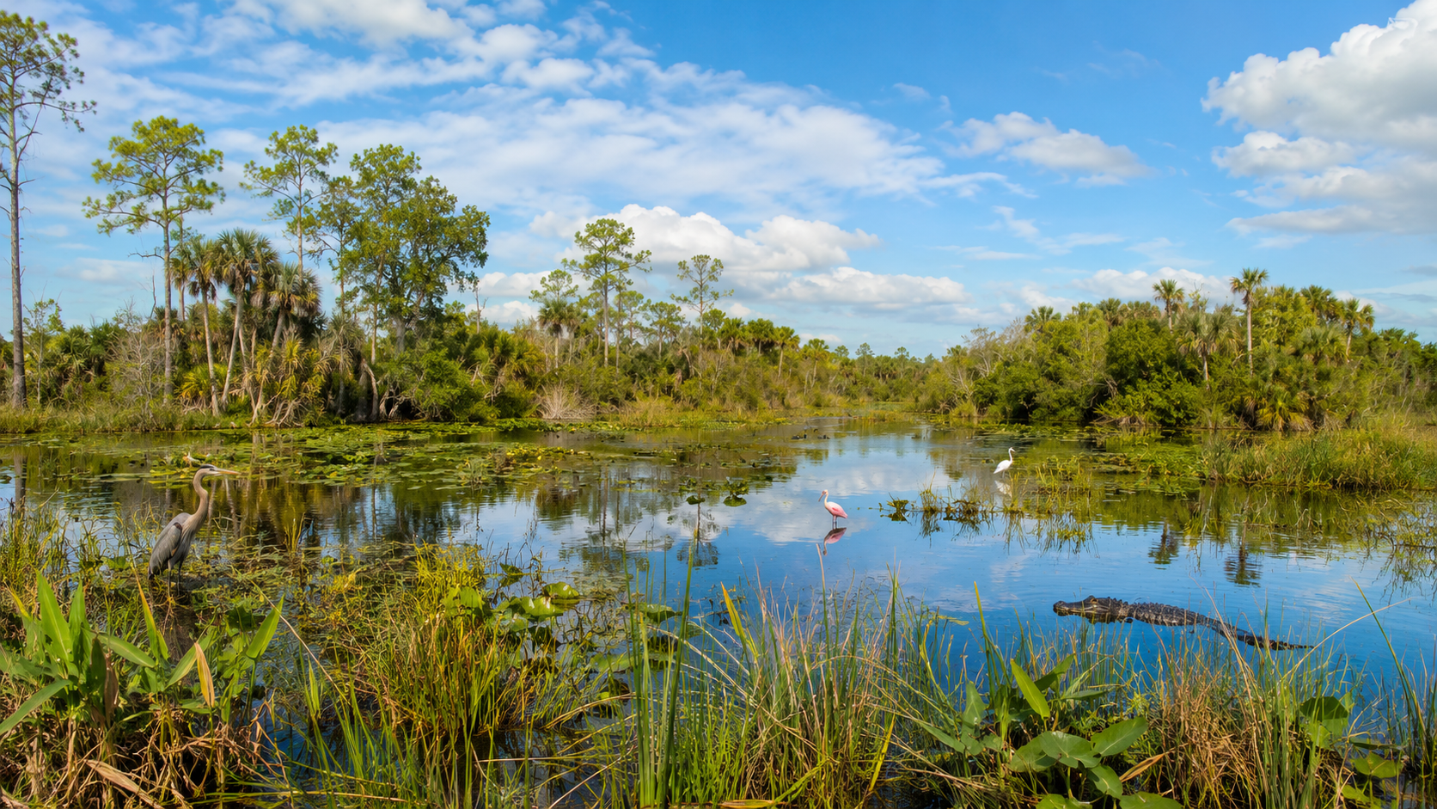
PHOTO · NATIONAL PARK BIODIVERSITY
Many Habitats, One Protected Place
National parks protect many kinds of habitats at once — forests, wetlands, meadows, and more.
National parks protect many kinds of habitats at once — forests, wetlands, meadows, and more. Each one is home to hundreds of species.

Slide 10
THE LESSON · SECTION 1
What Is Protected Land?
Some land in the United States is set aside by law. Nobody can build houses, factories, or farms there — these are called protected lands. National parks are one kind. People can visit and explore them, but the plants, animals, and water inside are kept safe from the kind of damage people can cause.
SCIENTIST TALK
If a forest has no protection, what kinds of things might happen to it over time?

Slide 11
THE LESSON · SECTION 2
Why Biodiversity Matters
A healthy ecosystem has many different kinds of living things — that variety is biodiversity. Each species plays a role: bees pollinate flowers, owls control the mouse population, decomposers break down dead leaves. When one species disappears, others can be affected. A place with high biodiversity is more stable and harder to break.
SCIENTIST TALK
What might happen to the plants if all the bees in a park suddenly disappeared?

Slide 12
THE LESSON · SECTION 3
How Conservation Works
Rangers and scientists work inside national parks — tracking animal populations, removing invasive plants, and reducing pollution. This work is called conservation.
Real-World Connection
The Everglades in Florida: over 50% of the original Everglades was drained for farms and cities. Today it is a protected national park, and scientists are slowly helping it recover.

Slide 13
TAP EACH ROLE
Remove One, All Are Affected
The interactive shows four roles in an ecosystem. Students tap each role to learn what it does — and what breaks without it.
Plants — Make food from sunlight.
Pollinators — Carry pollen, help plants reproduce.
Grazers — Eat plants, spread seeds.
Predators — Keep grazer populations in check.

Slide 14
KEY CONCEPT
One Web, Many Parts
KEY CONCEPT
Protecting land protects the entire ecosystem — the soil, water, plants, and animals that all depend on each other.

Slide 15
MIND-BLOWING FACT
Alligators and Crocodiles Together
The Everglades is the only place on Earth where alligators and crocodiles live together in the wild — but over half of the original Everglades was destroyed before people started protecting it.

Slide 16
CURIOUS? GO DEEPER
Ecologists and Keystone Species
Scientists who study ecosystems are called ecologists. They count species, measure water quality, and track animal movements over years — sometimes decades. One of their most important tools is the 'keystone species' idea — a species that holds the whole ecosystem together. Sea otters, wolves, and beavers are classic examples. Remove one, and the whole ecosystem can shift dramatically.
SCIENTIST TALK
Can you think of a keystone species that might live in the Everglades? What do you think would happen if it disappeared?

Slide 17
EXPLORE
Compare Two Places
Use the descriptions below to compare a protected and an unprotected area. Read about the two places, then fill out the comparison chart in your notebook.

Slide 18
REHEARSAL · READ THE TWO PLACES
Place A (Protected) vs. Place B (Unprotected)
Place A — Protected National Park: Protected for 80 years. Logging, hunting, and building are not allowed. Rangers monitor every season. Over 300 bird species, 50 mammal species, dozens of native tree types. Streams run clear.
Place B — Unprotected Forest: Sits next to a growing town. Trees cut for lumber, some land turned into parking lots. Fewer than 80 bird species. Several mammal species not seen in years. Streams run muddy after rain.

Slide 19
REHEARSAL · COPY THIS CHART
Category | Place A | Place B
Category | Place A (Protected) | Place B (Unprotected)
Bird species | write here | write here
Water quality | write here | write here
Mammals present | write here | write here
Human activities allowed | write here | write here

Slide 20
REHEARSAL · CIRCLE, SKETCH, PREDICT
Three More Steps
Circle one difference in your chart that surprises you most. Write a sentence explaining why you chose it.
Sketch one animal you would most likely find in Place A but NOT Place B. Label its habitat needs: food, shelter, water.
Write a prediction: If Place B became a protected area starting today, what do you think would happen over the next 20 years?
SCIENTIST TALK
Looking at your chart — what pattern do you notice? What does that pattern tell you about what protection actually does for a place?

Slide 21
REHEARSAL · RECORD YOUR THINKING
Organize What You Observed
What was the biggest difference you noticed between Place A and Place B?
What do you think caused that difference? Use the word "protection" or "habitat" in your answer.
Draw and label the animal you sketched. Show at least 3 things it needs to survive.
Tell the story of what you noticed — what you compared, what surprised you, and what it taught you about why protection matters.

Slide 22
DISCUSSION · THINK IT THROUGH
Think Through Each Question On Your Own
What happened to biodiversity when Place B lost its tree cover — and why do you think that happened?
What evidence in your chart supports the idea that protecting land helps animals survive?
If the Everglades were not protected, what kinds of animals do you think would be hardest hit? Why?
What is one human action — other than logging — that could reduce biodiversity in a wild place? What would you do to stop it?

Slide 23
QUICK SELF-CHECK · QUESTION 1
What Is Biodiversity?
What is biodiversity?
A) The number of people who visit a national park each year
B) The variety of different plants and animals living in one place
C) The amount of rainfall a forest receives each year
WHAT DO YOU NOTICE? WHAT DO YOU WONDER?
What do you notice in this scenario that helps you decide? What do you wonder about before you answer?
CHAT
Think back to the vocab card for biodiversity. It's about how many different kinds of living things share a space.
Notes:
Tests the core definition of biodiversity.

Slide 24
QUICK SELF-CHECK · QUESTION 1
What Is Biodiversity? — Answer
Correct: B — Biodiversity means variety: many different kinds of living things sharing the same place.
Notes:
Reinforce that biodiversity is about variety of species, not visitor count or weather.

Slide 25
QUICK SELF-CHECK · QUESTION 2
When a Habitat Is Destroyed
What most likely happens when a wild habitat is destroyed?
A) Animals find more food because there's more open space
B) Biodiversity in that area increases
C) Animals lose shelter and food, so some species may disappear
WHAT DO YOU NOTICE? WHAT DO YOU WONDER?
What do you notice in this scenario that helps you decide? What do you wonder about before you answer?
CHAT
Think about what animals need from their habitat: food, water, and shelter. What happens when those are gone?
Notes:
Tests cause-and-effect reasoning about habitat destruction.

Slide 26
QUICK SELF-CHECK · QUESTION 2
When a Habitat Is Destroyed — Answer
Correct: C — When habitat is destroyed, animals lose the things they need, and some can't survive without them.
Notes:
Reinforce that habitat loss directly harms the species that depend on it.

Slide 27
QUICK SELF-CHECK · QUESTION 3
Best Example of Conservation
Which of these is the best example of conservation?
A) Rangers monitoring and protecting a wetland from pollution
B) Cutting down trees to build a new road through a forest
C) Draining a swamp to create more farmland
WHAT DO YOU NOTICE? WHAT DO YOU WONDER?
What do you notice in this scenario that helps you decide? What do you wonder about before you answer?
CHAT
Conservation means protecting nature and keeping it healthy. Which option does that — instead of changing or removing the wild place?
Notes:
Tests classification of conservation vs. habitat-damaging actions.

Slide 28
QUICK SELF-CHECK · QUESTION 3
Best Example of Conservation — Answer
Correct: A — Conservation means working to protect and care for nature. Monitoring a wetland is exactly that kind of work.
Notes:
Reinforce that conservation actively protects rather than removes or alters wild places.

Slide 29
ASSIGNMENT · PART A
Sort the Actions
In your notebook, write each action under one of two headings: "Helps the Ecosystem" or "Harms the Ecosystem." Then write one sentence explaining your most important choice.
A ranger removes invasive plants that are crowding out native wildflowers.
A developer drains a wetland to build a shopping center.
Scientists track wolf populations to make sure the forest ecosystem stays balanced.
A logging company cuts down a large section of old-growth trees.

Slide 30
ASSIGNMENT · PART B & WRITE AND EXPLAIN
Short Answer + Make Your Case
Part B (complete sentences): 1) What is a national park? Give one reason protected land matters for animals. 2) Why is high biodiversity a sign of a healthy ecosystem? Give one example. 3) Describe one way humans harmed a wild ecosystem and one way people are trying to repair it.
WRITE & EXPLAIN — Is it worth protecting wild land, even if it means people can't build or farm there? Use what you learned today.
Start with: "I think protecting wild land is important because…"
Then: "I know this because the lesson showed that…"
Finish with: "This makes sense because…"

Slide 31
ASSIGNMENT · PART C & SUBMISSION
Draw & Label + What to Turn In
Part C: Draw a national park scene showing at least 3 different zones (like sky, forest, and wetland). Label each zone and write the name of one plant or animal that lives there. Show one human action that protects that zone.
SUBMIT ON CANVAS — must include:
Completed comparison chart for Place A and Place B
Part A sort (four actions labeled) and Part B short answers in complete sentences
Write & Explain response using at least one science vocabulary word
Part C national park drawing with 3 zones labeled and one conservation action shown

Slide 32
Great Work Today!
Coming up next: design your own park protection proposal.
Lesson 25.02 · Protect a Park Proposal

